Slide 1
Research Panel
Lunch & Learn
2/12/2016

Slide 2
Shiman Ding (Phil Kaminsky’s Group)

Slide 3
design, operation, and risk management in logistics systems and supply chains
Working with Phil
Research topics:
Supply chain collaboration
Supply chain flexibility
Batch order/production
Quantitative modeling of operating rooms
Amazon drone
Industry connection:
BioMarin, Bayer, Genentech, UCSF, etc.

Slide 4
Andres Gomez (Alper Atamtürk’s Group)

Slide 5
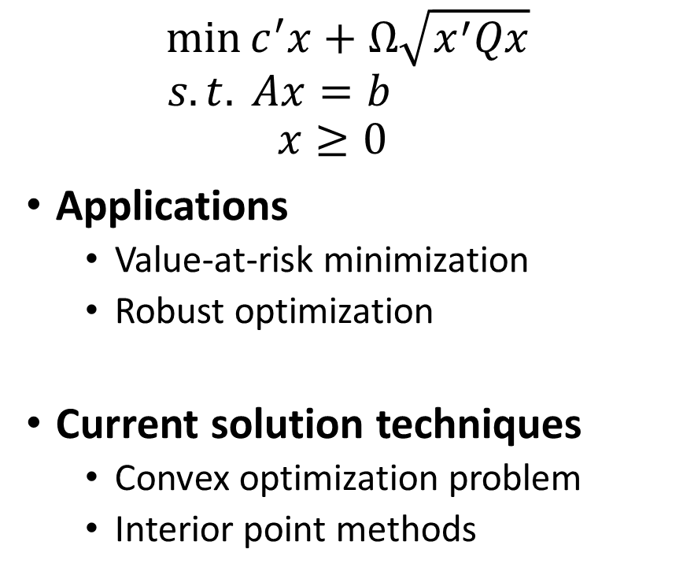
Simplex-based methods for conic programs Andres Gomez
$$\min{c^{′}x+Ω\sqrt{x^{′}Qx}}$$
$$s.t. Ax=b$$
$$x≥0$$
Applications
Value-at-risk minimization
Robust optimization
Current solution techniques
Convex optimization problem
Interior point methods
Proposed approach
Simplex method
Specific to the problem considered
More precision
Warm starts
Preliminary results
Speed ups of up to 20x compared to CPLEX barrier solver.

Slide 6
Dean Grosbard (Robert Leachman’s Group)

Slide 7
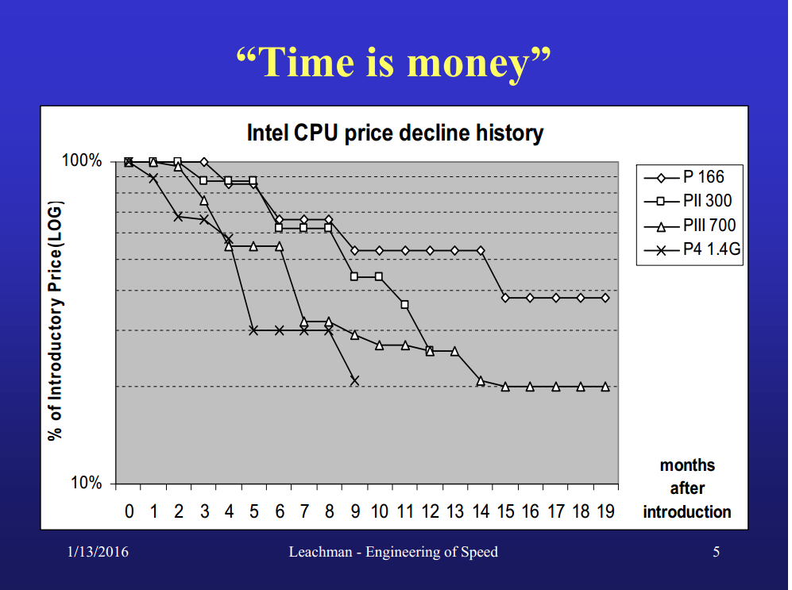

Slide 8
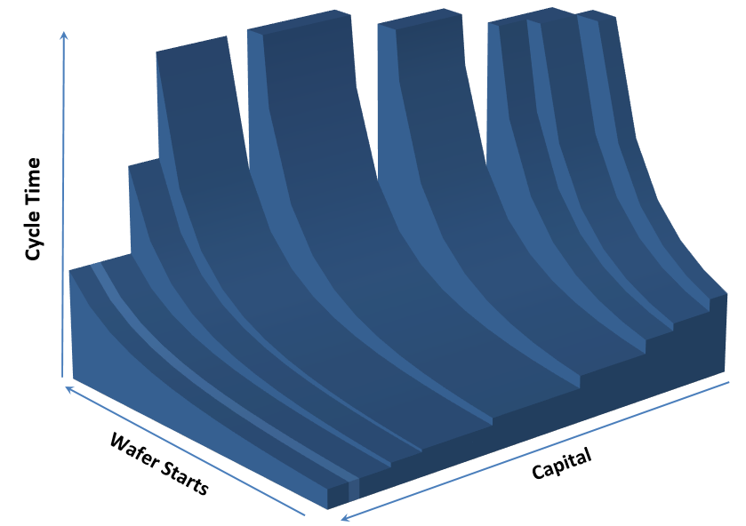
Where do we want to be ?

Slide 9
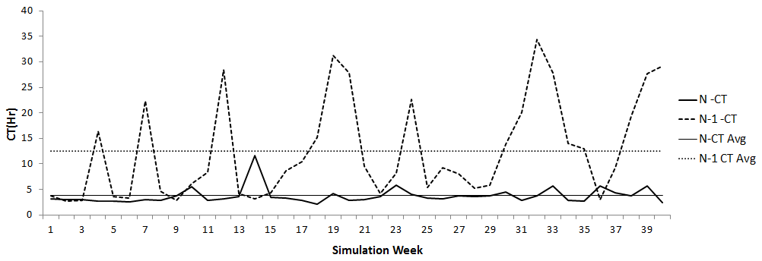
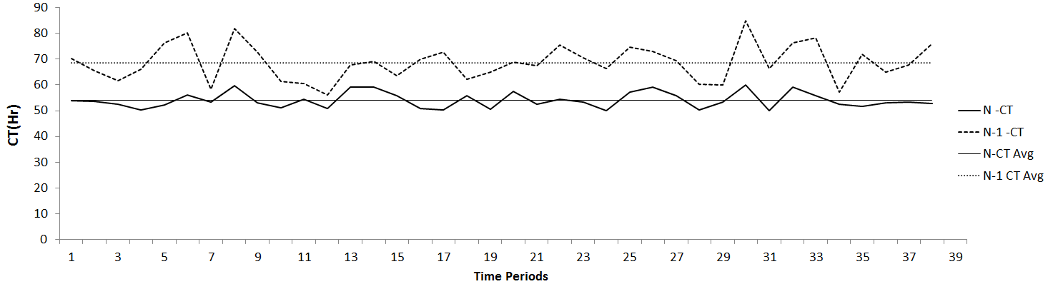
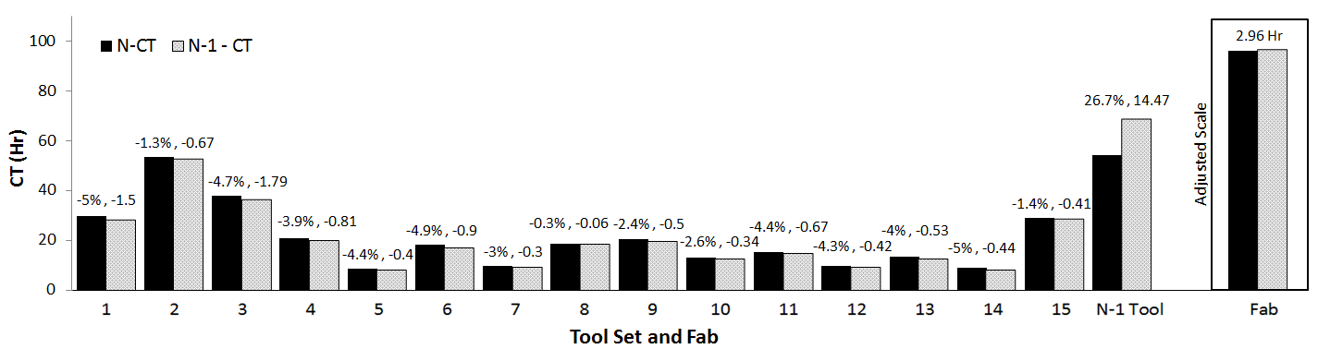
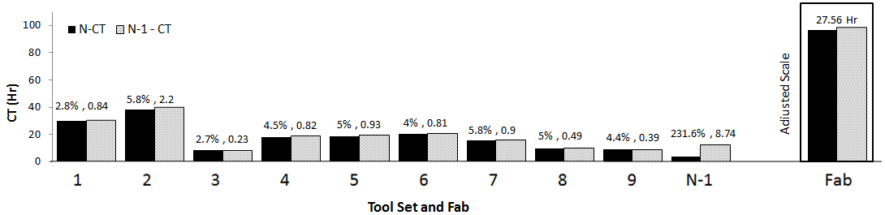
How do we get there?

Slide 10
Kevin Li (Candace Yano’s Group)

Slide 11
Multi-Product Dynamic Pricing and Inventory Control
Notes:
Motivation
Need -> Better testing, use past information better and understanding your customers

Slide 12
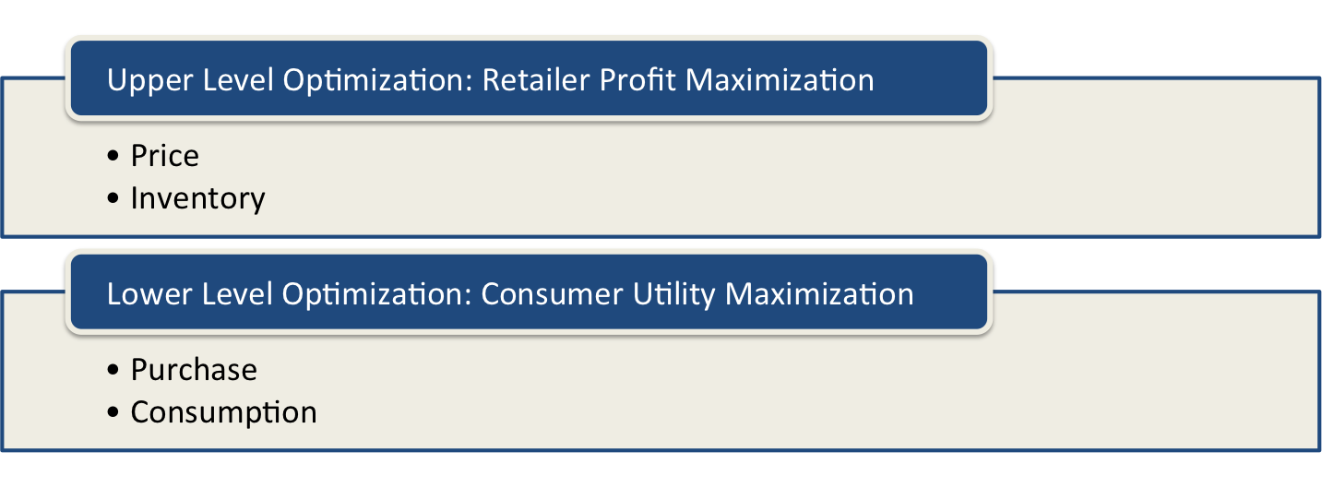
Multi-Product Dynamic Pricing and Inventory Control
Notes:
Model Approach – Upper and Lower Level
Methodology – Optimal Control, rational expectations equilibrium, NLP; Estimation – Structural Equation Modeling ..

Slide 13
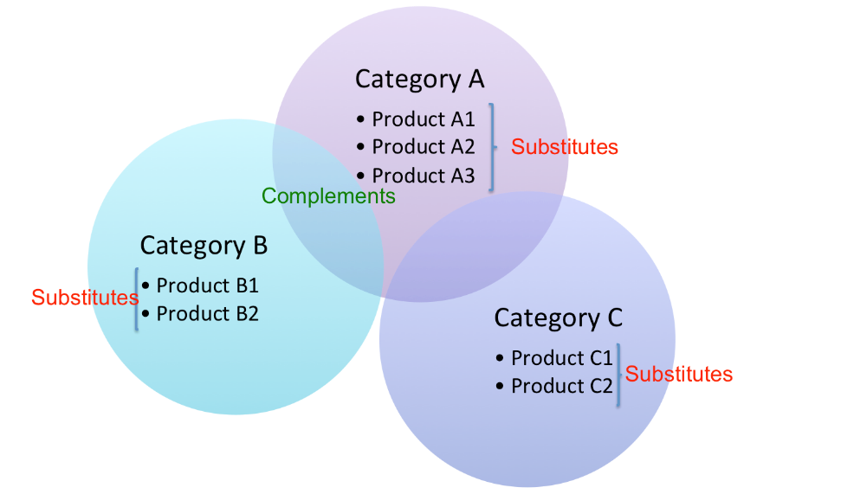
Multi-Product Dynamic Pricing and Inventory Control

Slide 14

Multi-Product Dynamic Pricing and Inventory Control

Slide 15
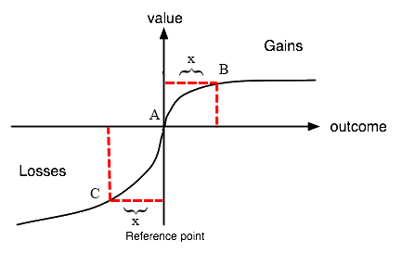
Multi-Product Dynamic Pricing and Inventory Control

Slide 16
Yonatan Mintz (Anil Aswani’s Group)

Slide 17
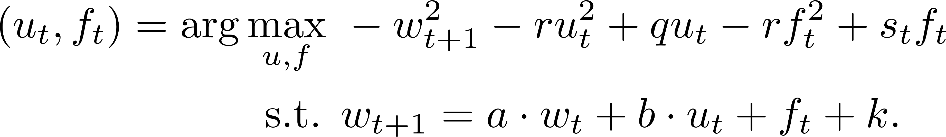
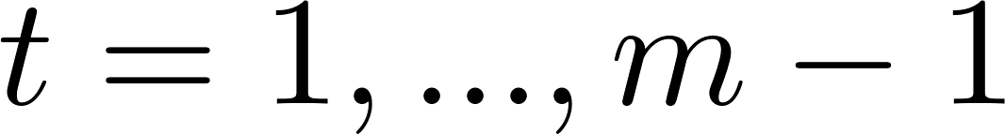
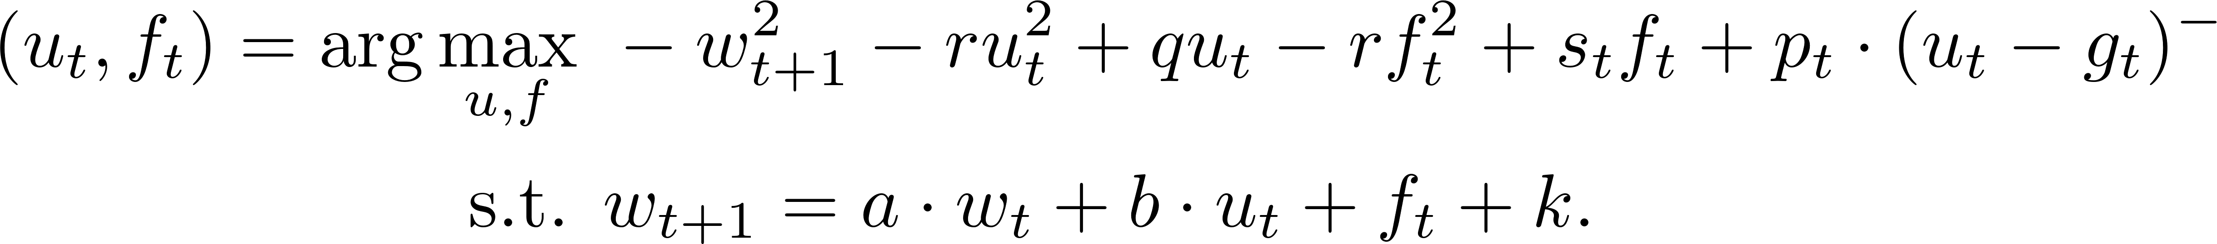
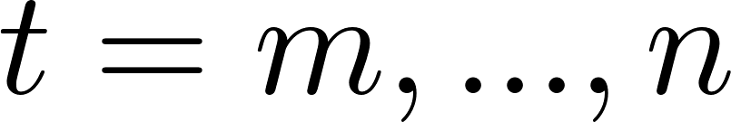
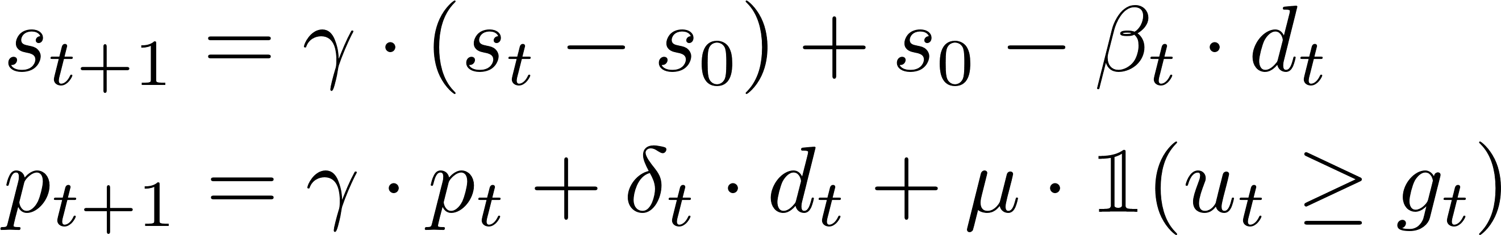
Modeling Framework
Challenge: Significant amount of missing data and noise
Approach: Jointly estimate parameters and noisy/missing data
Time interval of first visit

Slide 18
Computation and Extension
Posterior Probability
MAP Estimation
Estimation
Design
Individual 1
Individual 2

Slide 19
Jiayin Shi (Shmuel Oren’s Group)

Slide 20
Stochastic Unit Commitment with Topology Control Recourse for Renewables Integration
Jiaying Shi, Shmuel Oren
Department of Industrial Engineering and Operations Research,
University of California at Berkeley, Berkeley, CA, USA
We introduce a two-stage stochastic unit commitment formulation for electricity power system with renewable generation, in which the second stage recourse actions include possible reconfiguration of the power grid topology through transmission line switching.
We conducted numerical test on IEEE 118 system with 48,336 binary variables and 80,352 continuous variables to demonstrate the benefits of such adaptive topology control.
Our results show that such recourse capability in response to realized uncertainty of intermittent renewable resources can mitigate such adverse variability and significantly improve unit commitment efficiency.
We are now working on scalable decomposition methods.

Slide 21
Renyuan Xu (Xin Guo’s Group)

Slide 22
Smart Order Routing
Renyuan Xu, Xin Guo
Department of Industrial Engineering and Operations Research,
University of California at Berkeley, Berkeley, CA, USA
Platforms selection and order allocation for a certain time period
Partial information: censored data, limited public information
Discrete case: (1) Markov Decision Process
(2) Under certain assumption: closed form solution
(3) Future work: Reinforcement learning under bandit setting
Continuous case: (1) Stochastic control with jump diffusion
(2) HJB equation, viscosity solution
(3) Future work: numerical PDE

Slide 23
Min Zhao (Zuo-Jun (Max) Shen’s Group)

Slide 24

Barter Exchange
Inventory exchange
Examples:
Hotel & media;
Employee discount programs
Volume
65% of corporations listed on the NYSE use barter
20-25% of world trade is barter
$12 billion recovered in 2008 claimed by IRTA

Slide 25
Barter Exchange
A relatively new topic
Technical details:
using continuous time Markov chain and random graph to model the ability to exchange between participants.
Focused on participants waiting time within the barter platform.
Difficulties:
Due to lack of reference, it is challenging to find the model that correctly characterize the exchange system.

Slide 26
Mo Zhou (Ken Goldberg’s Group)

Slide 27





The CAFE (Collaborative Filtering and Assessment Engine)
Mo Zhou, Ken Goldberg
Department of Industrial Engineering and Operations Research,
University of California at Berkeley, Berkeley, CA, USA

Slide 28


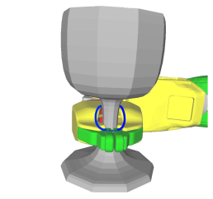
The Automation Lab

